Slide 1
Customer Retention Case Study
- Shubham meshram

Slide 2
Contents : -
Introduction
a. What is Customer Retention?
b. Why customer retention is so important?
c. What are the factors influencing customer retention?
2. Problem Statement
a. What is the problem about.
b. Important libraries to perform the operation.
3. Problem Solving Approaches, Data Analysis, Data Visualization Techniques and observation.
4. Conclusion

Slide 3
Introduction
1. What is Customer Retention?
Customer retention is the collection of activities a business uses to increase the number of repeat customers and to increase the profitability of each existing customer.
Customer retention strategies enable you to both provide and extract more value from your existing customer base. You want to ensure the customers you worked so hard to acquire stay with you, have a great customer experience, and continue to get value from your products.
In short, acquisition creates a foundation of customers while your retention strategy is how you build customer relationships and maximize revenue for each one.

Slide 4

Why customer retention is so important?
Customer retention seems equally important for any eCommerce store irrespective of their survival. It measures the success rate of a store’s new customers and spread out ideas to satisfy their existing customers too.
Retaining customers are easier and are affordable than acquiring new ones. According to a fact, a 5% increase in customer retention can increase company revenue by 25 to 95%.
Customer retention measures not only how successful a company is at acquiring new customers but also how successful they are at satisfying existing customers. It also increases ROI, boosts loyalty, and brings in new customers.

Slide 5
What are the factors influencing customer retention?
There are plenty of factors that go into the customer journey , but there are a few main things to focus on to provide a seamless experience.
a. Product discoverability: Figure out where your audience likes to shop and make sure you sell on those channels.
b. Website navigation: Make it easy to explore your website and find what they’re looking for. Don’t confuse shoppers with complicated page navigation and too many menu options.
c. Inventory availability: Stay in stock, so shoppers can get their items ASAP. If you can’t avoid going out of stock, provide backorder options.
d. Payment options: Give your shoppers the option to pay how they want to. You should allow guest checkouts, and multiple payment options like Gpay, Phone pay, other UPI methods and the standard credit card checkout and etc.

Slide 6
e. Delivery Speed and Reliability: More than one-third of shoppers won’t return to a retailer following a lousy delivery experience — making shipping a key customer retention factor. Delight your customers with fast and free shipping, tracking information, and reliable delivery.
f. Customer Service: Nearly half of customers buy more following a good customer service experience — even if that experience involved an initial complaint. Not all customer service has to involve a complaint either – you can provide customers with proactive support that makes them feel valued and Etc.

Slide 7
Problem Statement
What is the problem about.
Customer satisfaction has emerged as one of the most important factors that guarantee the success of online store.
The data represents Key Performance Indicators of the Indian Online business which can be analyzed and make inferences on the key findings of data.
The dataset consist of many attributes which represents customer details, behavior, e-commerce customer services details and feedback columns.
The data is provided from Fliprobo technologies in excel format which has 2 sheets,
One is detailed overview of all columns another coded file.

Slide 8
Important libraries to perform the operation.
To perform the operation we need to import some necessary libraries.
a. NumPy : NumPy can be used to perform a wide variety of mathematical operations on arrays. It adds powerful data structures to Python that guarantee efficient calculations with arrays and matrices and it supplies an enormous library of high-level mathematical functions that operate on these arrays and matrices.
b. Pandas: Pandas is a Python library is used to analysis the data in different variation.
c. Matplotlib: Matplotlib is a plotting library for the Python programming language and its numerical mathematics extension NumPy.
d. Seaborn: Seaborn is a Python data visualization library based on matplotlib which provides a high-level interface for drawing attractive and informative statistical graphics

Slide 9
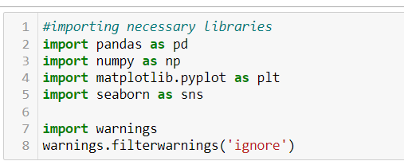
Operation performed.
We have imported the necessary libraries to perform the operation.
With the help of these libraries we have successfully imported the Data and further we can analyse and visualize the data.

Slide 10
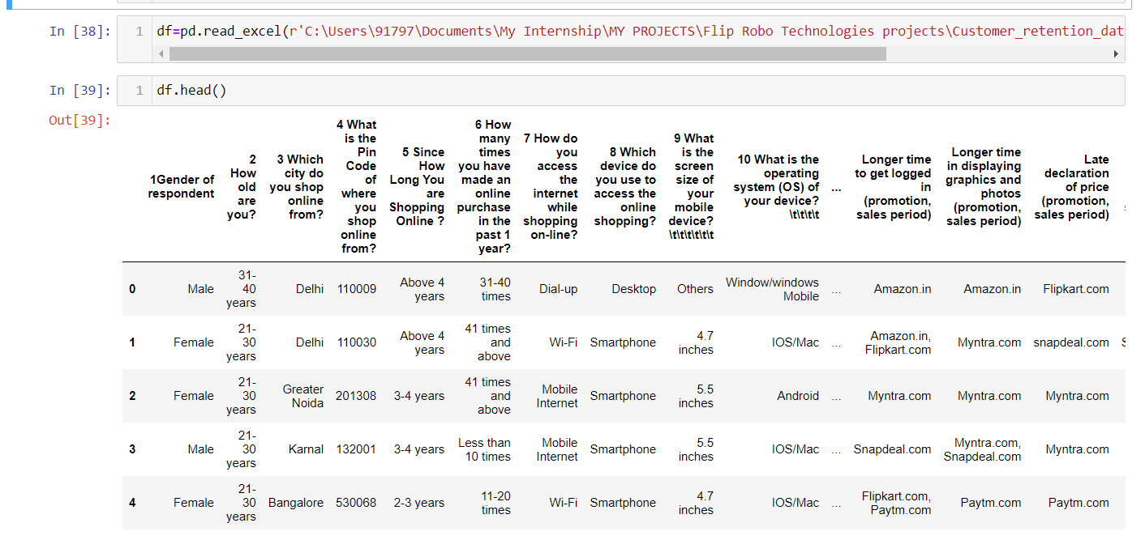
After importing the Data set the first five data is shown in the fig.

Slide 11
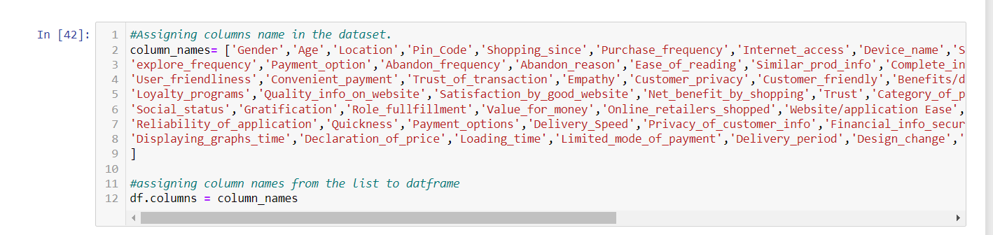
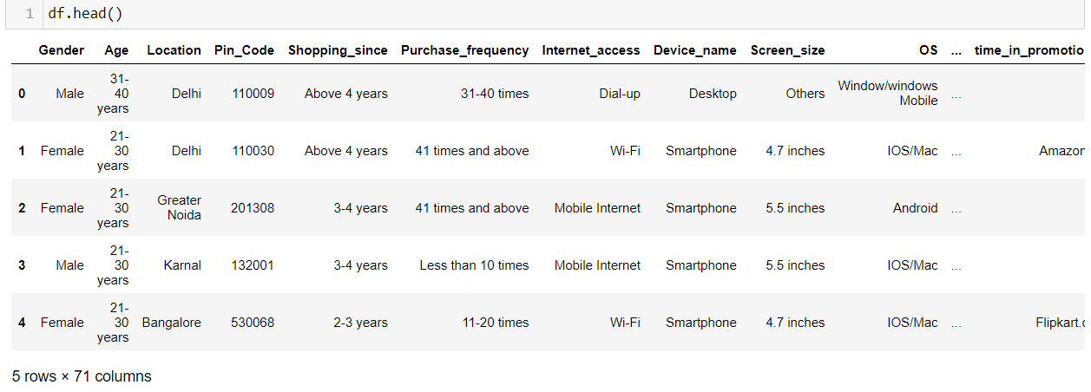
The column which was in the descriptive format, we have changed the columns names and executed.
we have converted the descriptive column name in the short, so that it is easy to understand. It is the fist five data from the dataset.

Slide 12
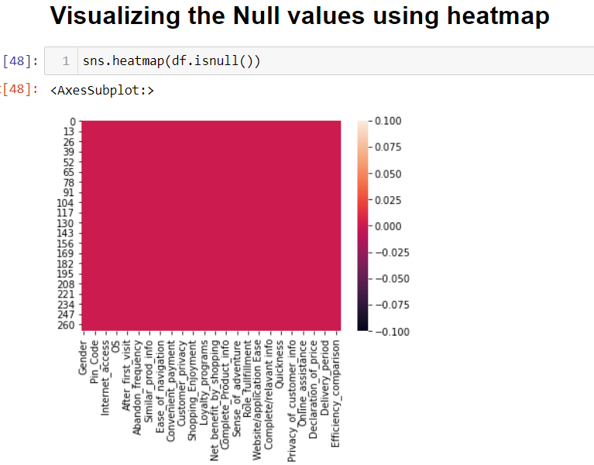
Checking for the Null Values.
Here we have checked the Null values present in the Datasets or not. Checking null values among the datasets is very important as it can affect the our machine learning model.
As per analysis

Slide 13
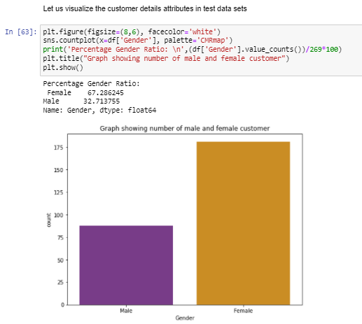
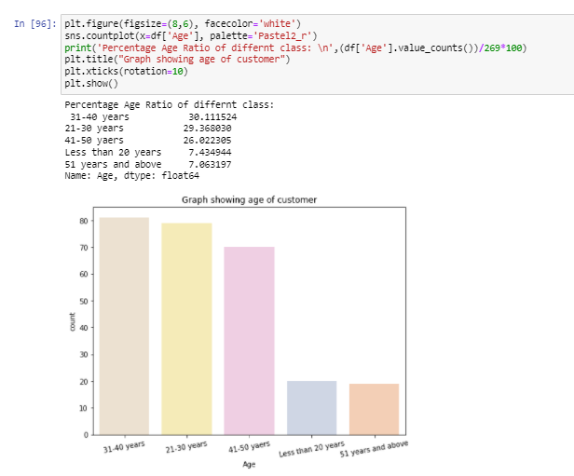
Data Visualization
1. The number of women customer shopping online is higher than that of men, 68% of customer are Women.
2. Nearly 31-40 aged people are seen to be shopping online the most. People aging from 21-50 makes around 85% of total customers who are shopping online.

Slide 14
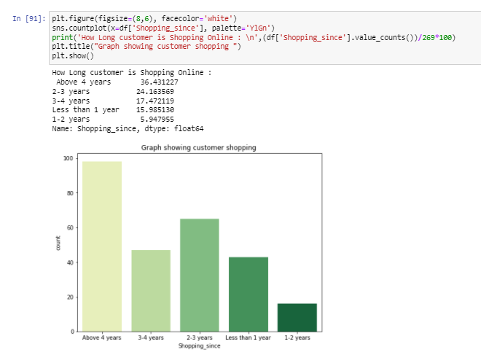
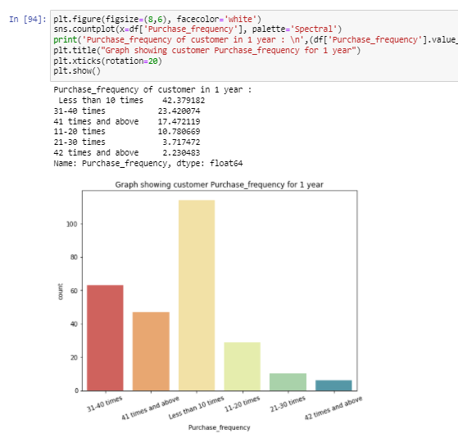
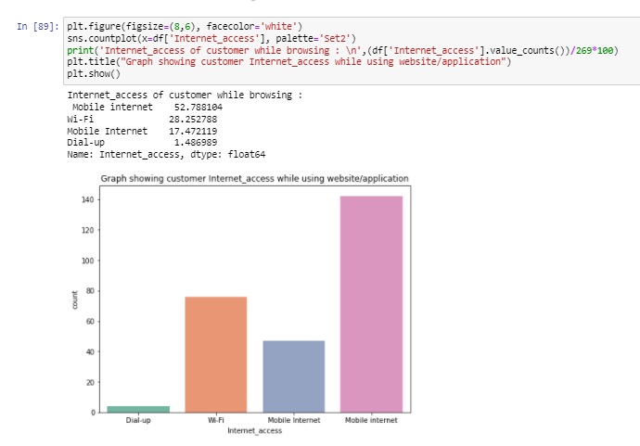
1. People shopping since 4 years make nearly 36-40% of customers, and customer shopping 80% of total customer are shopping since more than 2 years.
2. High number of people have voted to shop less than 10 times in a year. Hence this category of data need to be focused more in order to improve action and retention.
3. 70% of people using the application make use of Mobile Internet to shop online.

Slide 15
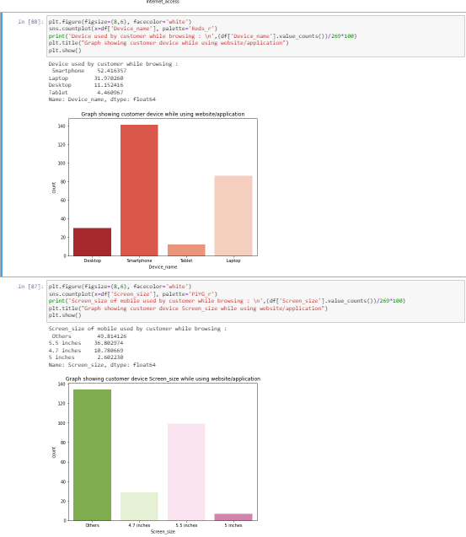
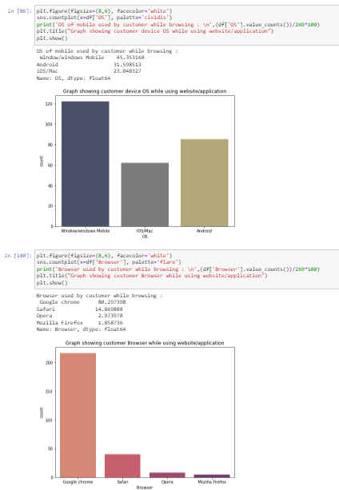
1. Customer shopping from mobile comprise of more than 50% of total customers.
80% percent customer accessing online shopping website are Chrome users. We can say that chrome provides user friendly interface which is liked by most of users.
2. Channel followed by user to arrive at the favorite online store for the first time is Search_engine
3. 45% customer uses smart phones to access online shopping and 42% customers use windows OS.

Slide 16
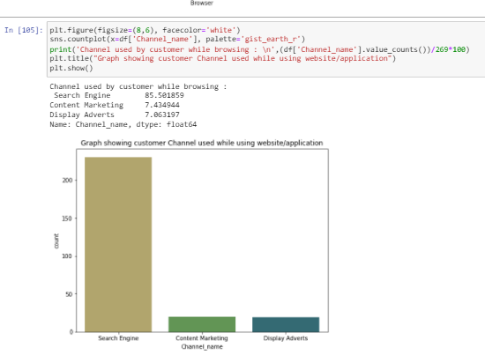
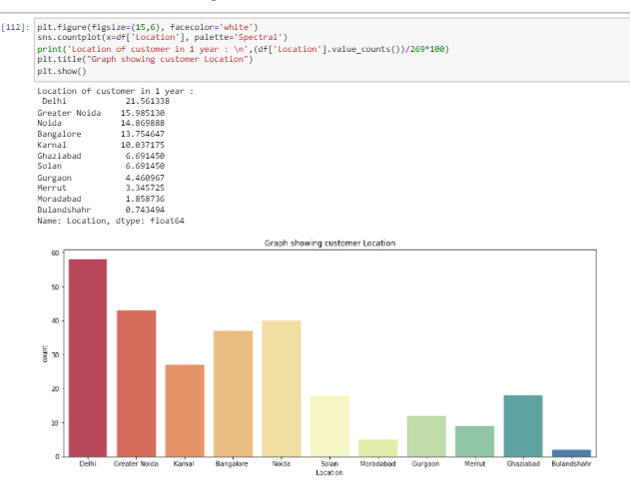
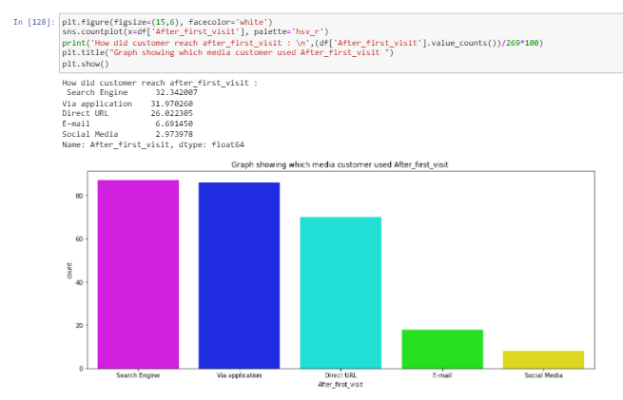
Channel followed by user to arrive at the favorite online store for the first time is Search_engine.
Highest online shopping is done from Delhi region with 21% of total customes, followed by Greater Noida, and Least is Bulandshahr.
90% of Customer has reached the websites after first visit through search engine, application and company URL.

Slide 17
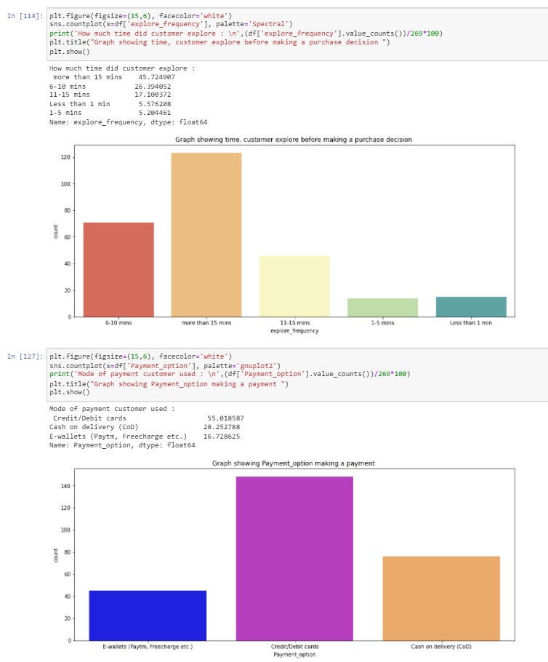
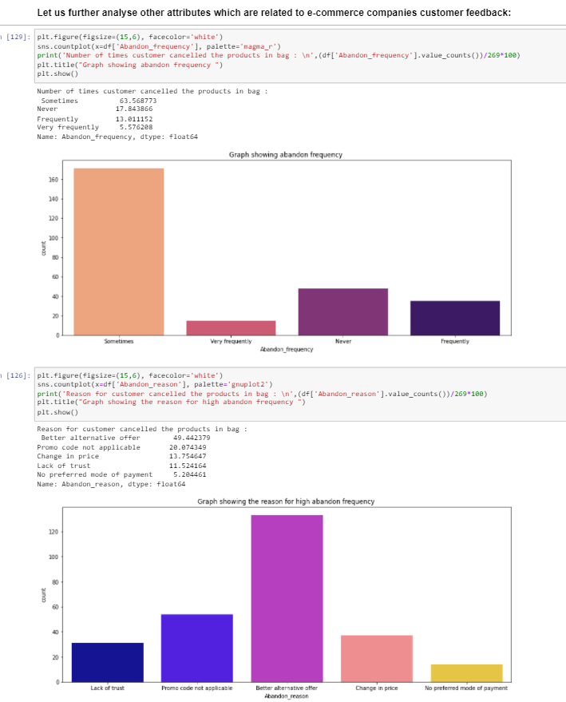
1. Most of the customer has spent more than 15 minutes before making the decision of purchase.
2. Customre feels ease of using Debit/Credit cards and COD as mode of payment while making an order. This may be due to availability of any cashback offers or customer see reliabilty in COD payment.
3. 65% of Customers have voted that they abandon the products in bags "Sometimes".
4. More than 50 % of customer has abandoned the bag as they got another alternative, but nearly 30% of customer abandoned due to lack of trust and not available mode of payment, by focusing on providing good benefits and multiple mode of payments may reduce these columns into 0.¶

Slide 18
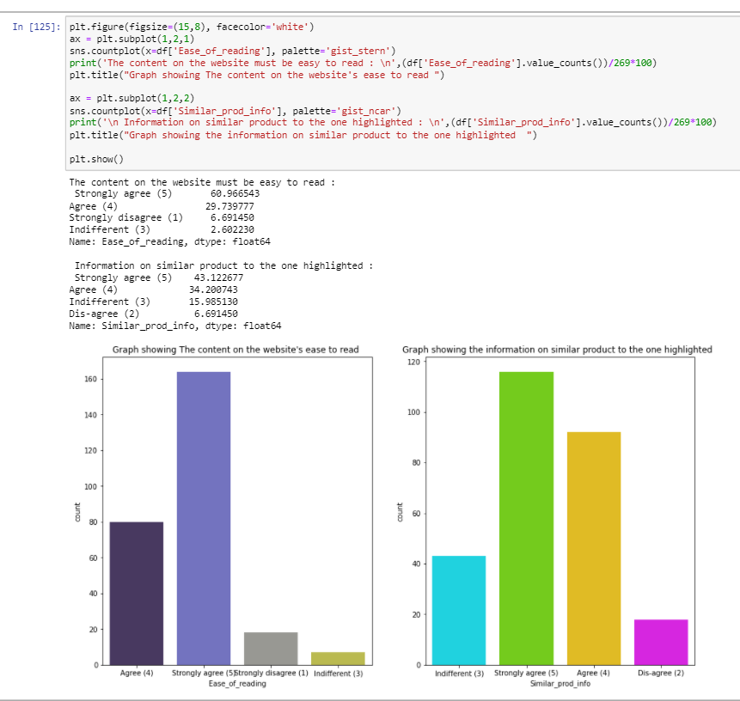
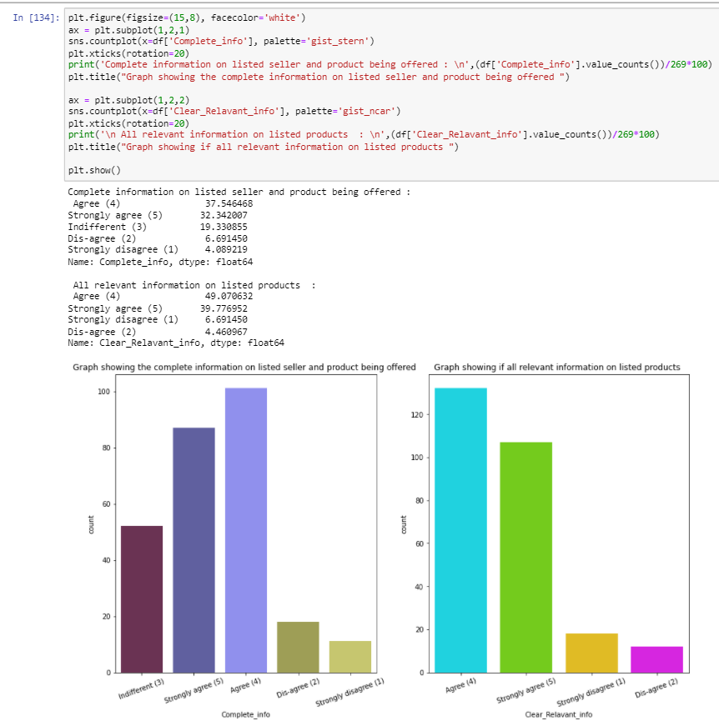
1. 90% of customer agree or Strongly agree that the content on the website is be easy to read and understand. Further improvement can be directly made by asking customer feedback and taking hypthesis if that decision holds good for all population.
2. 80% of customer agree that information on similar product to the one highlighted is important for product comparison.
3. 75% of customer agree that if product is to be bough by most of customer then, complete information on listed seller and product being offered is important for purchase decision.
4. 90% agree that to make a clear decision on purchase of product all the relevant information on listed products must be stated clearly

Slide 19
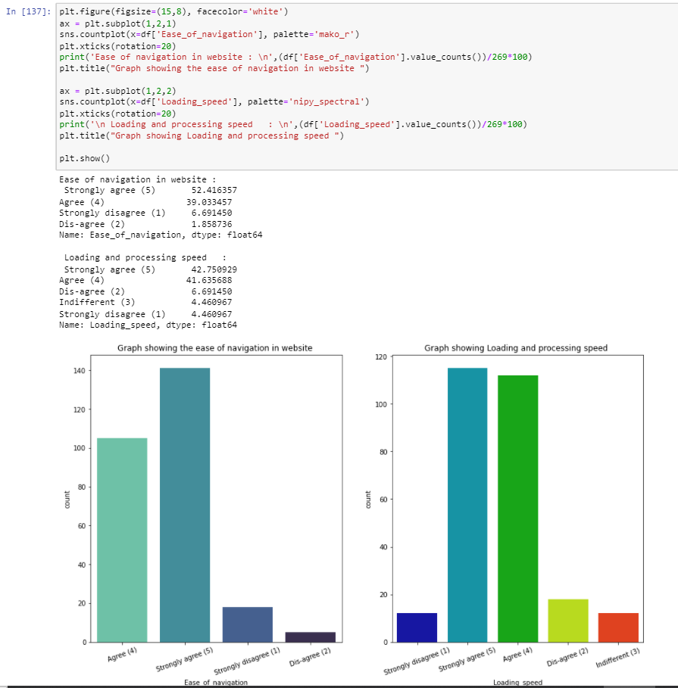
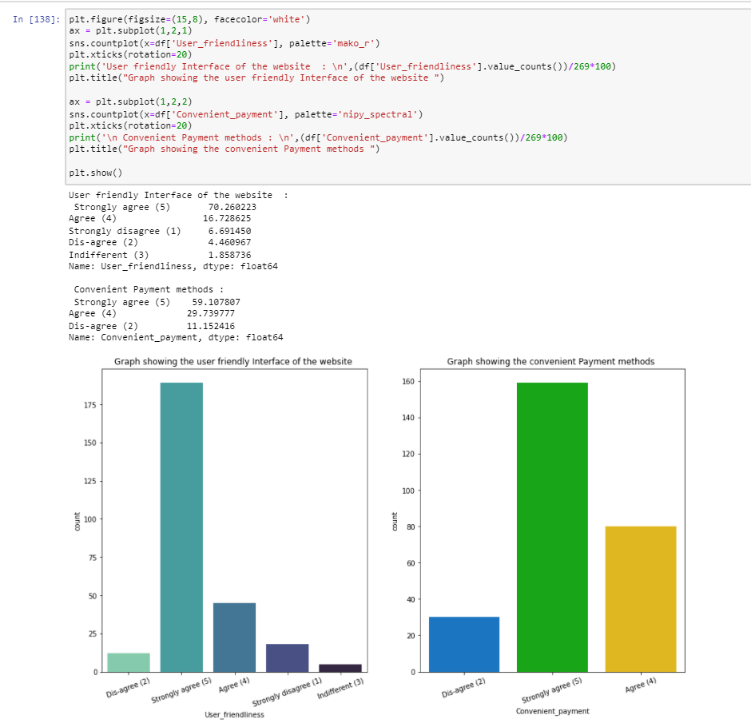
1. It is evident that companies website should have better ease of navigation in website to make more customer interaction and customer activation.
2. The website/Application should have better loading and processing speed, agreed by 85% of customers.
3. Website having user friendly Interface will have high customer interaction, strongly agreed by 70%
4. 60% of customer strongly agree that comapanies have convenient mode of payments.

Slide 20
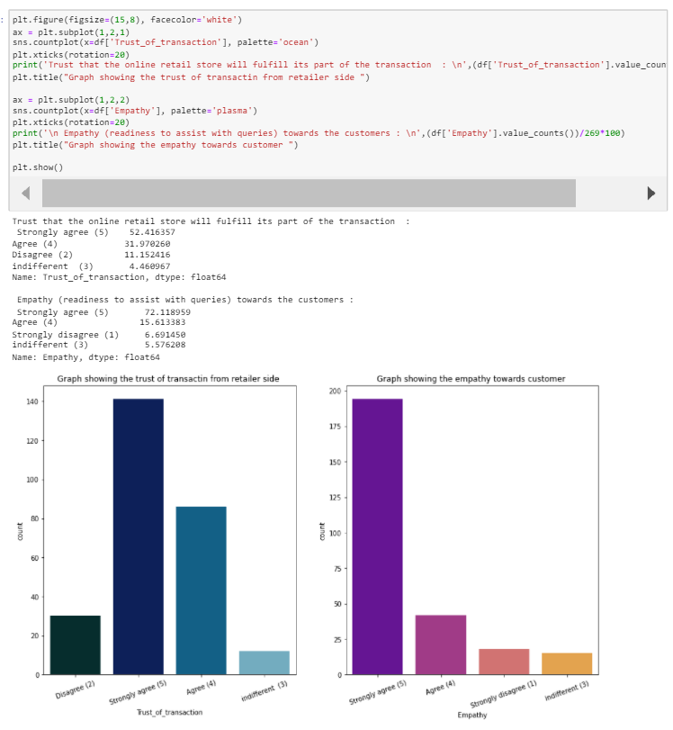
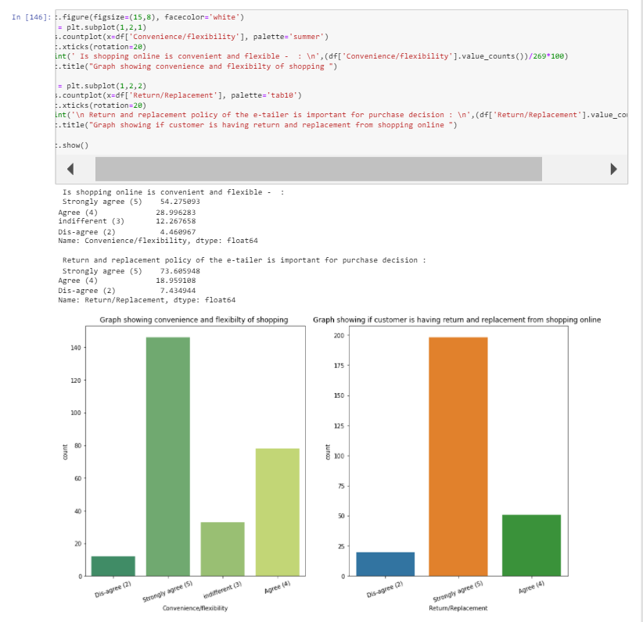
Customer have agreed that there is trust of transaction with the online retailers.
They strongly agree that customer executives have empathy towards customers problems.
3. Customer strongly agree that customer care executives behave with empathy towards customer problems/issues.
2. Customer have strongly agreed that customer data privacy is guranteed and Responsiveness is more customer friendly.

Slide 21
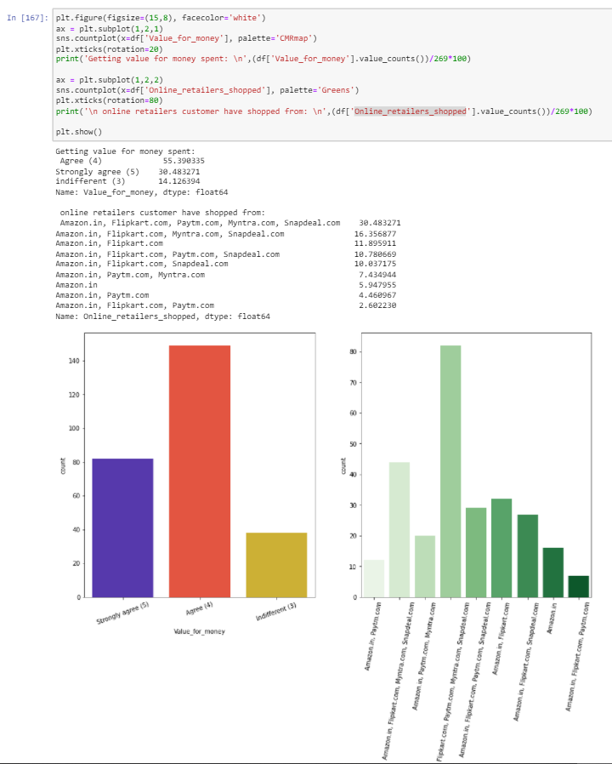
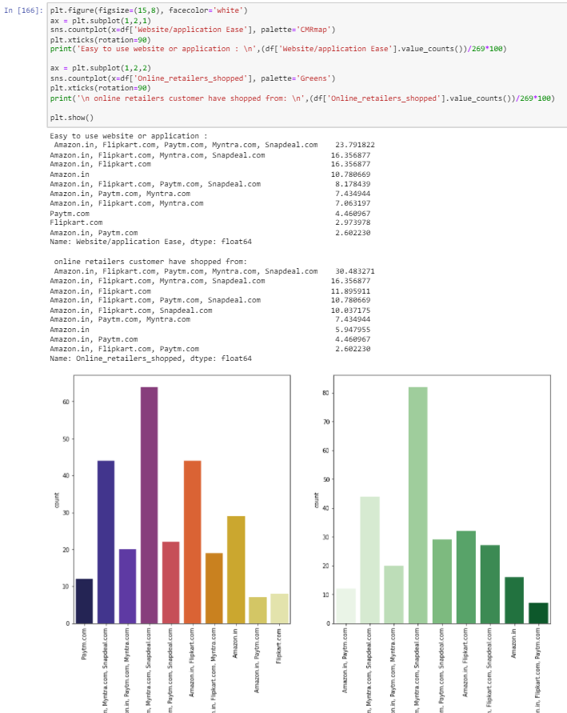

Slide 22
Customers have strongly agreed the following below points:
Benefits and Discounts are provided by online shopping retailers, and they have enjoyed the shopping experience.
Convenience and Flexibility in shopping online, Return/Replacements are provided for the products purchased.
Loyalty benefit programs are benefits for online shopping,
Information provided on website have quality information of products and improves customer satisfaction.
Net benefits by online shopping leads to customer satisfaction
Online shopping provides wide variety of products listed into websites.
There is provision for complete product information.
From online shopping the monetary savings can be done.¶

Slide 23
People agreed or have indifferent feeling on below attributes
37% customer have indifferent feeling on Gratification on e-retailer
32% of customer have indifferent feeling that shopping online fills the role.
55% customer believes that online shopping give value for money.
* Amazon being top player in the e-commerce business, is one of common Online_retailers_shopped by all customers.

Slide 24
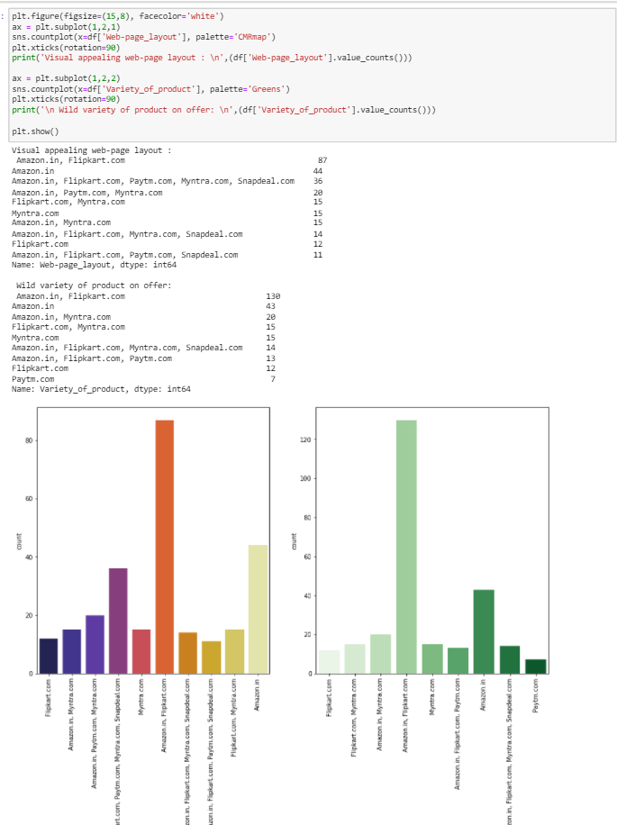
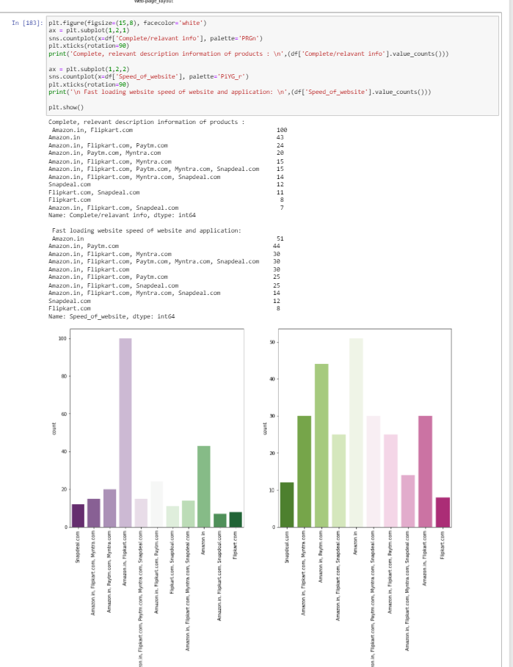
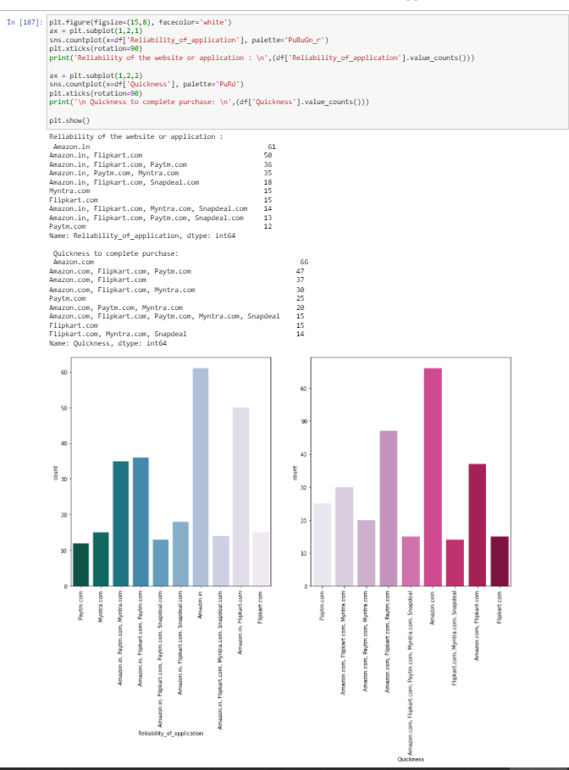

Slide 25
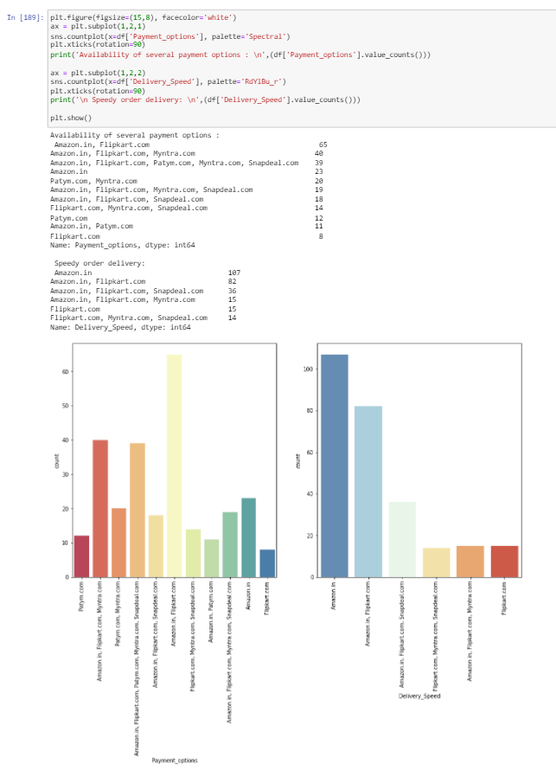

Slide 26
Observations
Amazon and Flipkart are the online shopping applications/websites with good web-page layout, comprise of 32% of customer votes
70% of customers say that wild variety of products are listed in Amazon and Flipkart
15% of customers believe the reliability of amazon website is better followed by Flipkart, Myntra, Paytm, Snapdeal
Amazon has quickest purchase time as per customer feedback comprise of 28% of total feedback
Wide range of payment methods must be provided by online websites/application in order to attract higher customer base.
In order to retain the customer, we must work more on waiting period for delivery, which can be done by appointing more logistics option internally as well as externally.¶

Slide 27
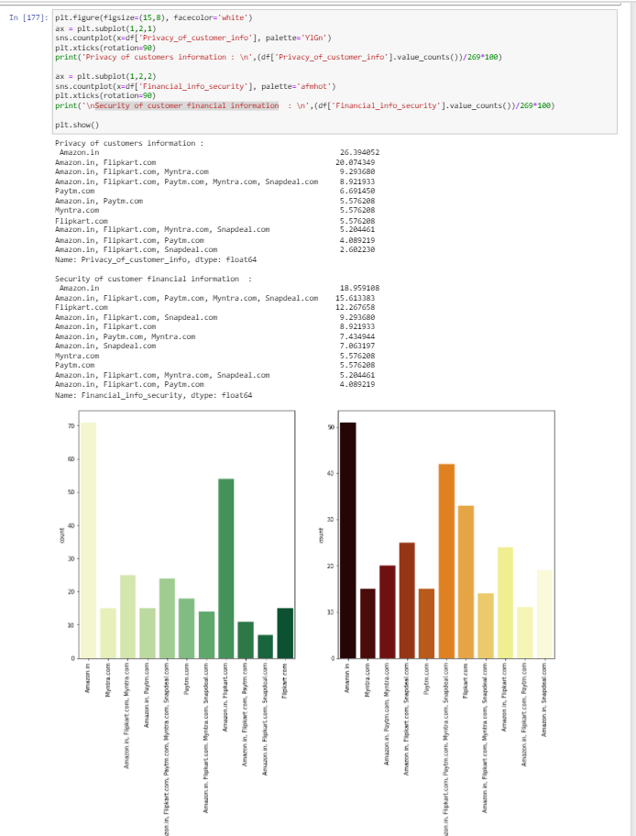
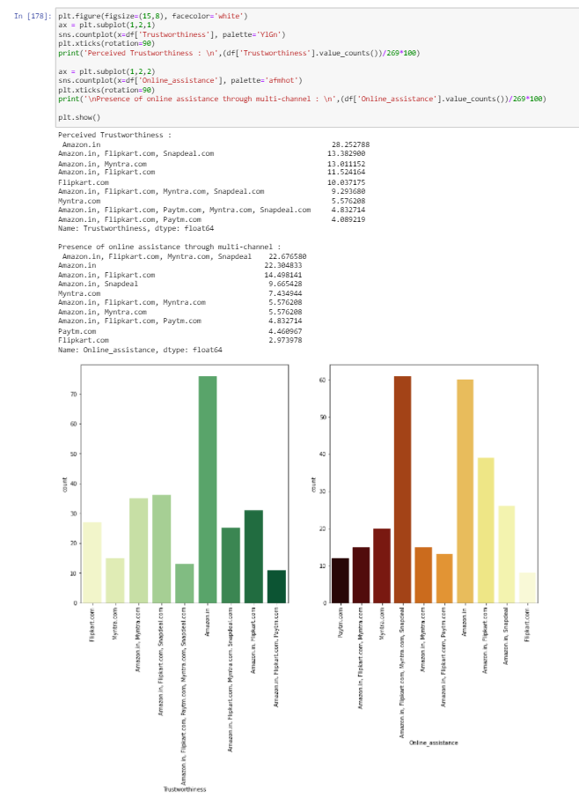
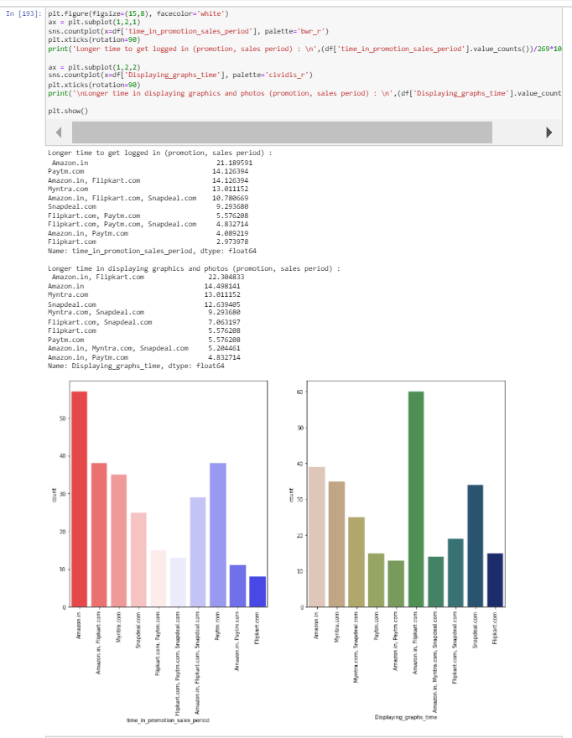

Slide 28
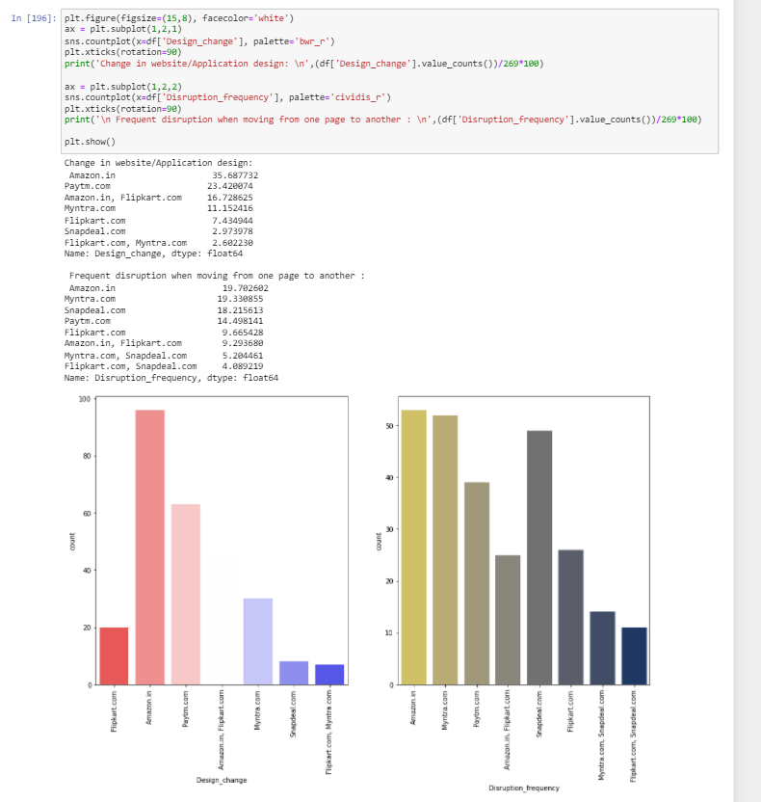
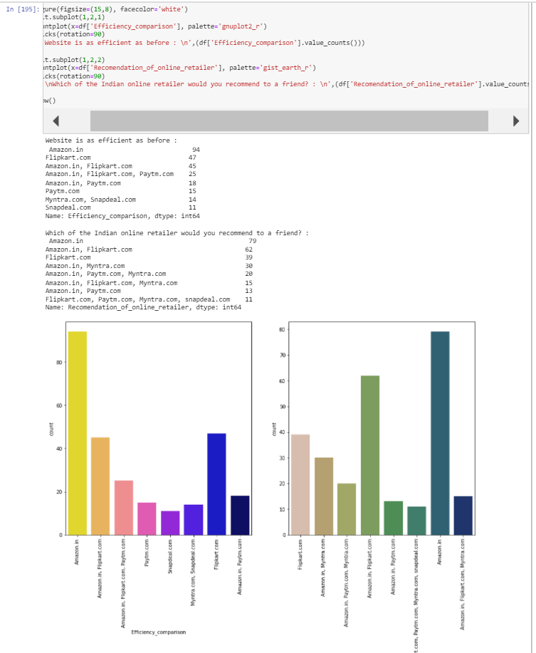

Slide 29
Observations:
Privacy of customers information: When customer uses online shopping, they will be sharing all the personal/private information to the retailers, Keeping the privacy of customer is one of toughest though most important thing which helps in building trust in customers
Financial information: shared by customer during payments will be saved in online store databases. Hence keeping the financial information safe makes the them reliable towards customer.
Trustworthiness: built up towards customer might be one of important reason to increase customer database
If customer who have made online shopping from any retailer, Resolving their issues w.r.t to product should be important to attract them again form online shopping, Presence of online assistance through multi-channel should be kept by online retailers.
To increase the number of customers attracting to online shopping, online retailers should focus on increasing sales promotion.
Online websites/applications should be having attractive product information and images/ graphics in order to make products more visible for shopping. While it should also be kept in mind to keep time constraints of loading the websites/images.
Online retailers will always be trying to bring any changes in their websites so change in website/Application design will be important to increase customer interaction.
Website/application efficiency are calculated by how fast the website can bring up the results, how big traffic it can hold with out being disrupted and how light the application is. It must be designed keeping all the constraints in mind to be more efficient.
Finally, recommendation is something one does when that product is impressive and has been outstanding with all the competitors.
We can see that amazon has got 79 individual votes out of 269, and Flipkart has got 39 votes from the customer choose.

Slide 30
Conclusion:
Online retailers should be more focused on providing convenient mode of payments so that customer feels safe to share the private and financial information for transactions and make sure the privacy retention of customer is the goal.
E-commerce businesses must provide wild range of variety of combinations for the products which make the customer to choose which is best suitable for there use case, also make sure that products listed on the site are trustworthy and maintain quality. Customer also be provided with return and replacement policies.
Overall customer should be provided with such a service that he is coming back to us with all heart looking for the value for the money he spent on our products, such services create trustworthiness between customer and sellers.
Looking at above surveys took between couple of the online retailers, Amazon has been the best customer friendly, reliable, user friendly, customer service focused company which has excellent customer assistance at hand to provide all the information, help needed by customer hence such environments attract huge customer bases, and a smaller number of churns are seen.
By the recommendations provided Amazon bagged 21% of overall upvotes which makes that amazon is leading in its own sector. Though there are some drawbacks like 'mode of payments' and 'Speed_of_website', 'website application ease' which company needs to work on to improvise near actions and attract more customers.
Likewise, company has been constantly focusing on providing customer benefits and discounts on products to attract huge base of customer.

Slide 31
Thank You

